Slide 1
SOCIAL STUDIES VISUAL DICTIONARY EXAMPLE

Slide 2
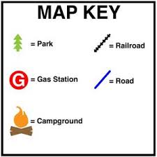
Map Key
A table used on a map or chart

Slide 3
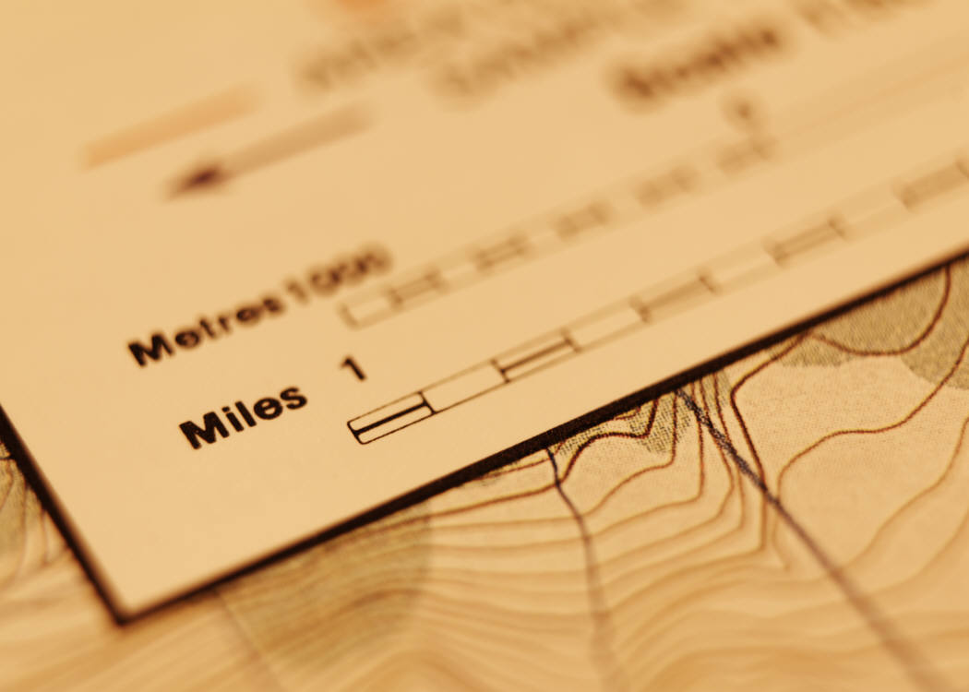
MAP SCALE A scale used to show distances on a map compared to true distances on Earth

